Slide 1

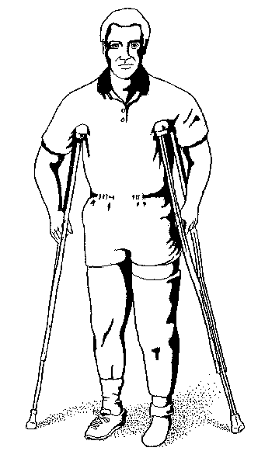
IEP
Individualized Education Plan in relationship to
IDEA
Completed by Team A
Kathy Capen, Maria Delvecchio,
Denise Mitchell, and
Renee Bottersbusch
-amended by Congress in 2004
(P.L. 108-446)

Slide 2
What is an IEP?
*The IEP is a document developed by a team of person’s from
the child’s attending school system who have a direct relationship
to helping the student with special needs to be able to reach his
full potential.
*It is used to better understand how and what a child needs to
succeed in his education.
*It is there to serve as a road map to address the child’s goals.
progress, and services.
*It is a legal document that is required for each student in the
Exceptional Children’s Program.

Slide 3

IEP Amended 2004
Special Education law mandated changes
Must include information about students functional ability to perform & academic levels
Must include measurable yearly goals that are academic and functional
Parents to be provided progress reports
(Wright and Wright, 1998)

Slide 4
Members of the IEP team
Each meeting should include, but is not limited to, the following participants:
A local representative from the school agency
The child's teacher.
One or both of the child's parents or responsible party
The child, where appropriate.
Other individuals at the discretion of the parent or agency.
(Messina and Messina, 2006)
(U.S. Department of Education, 2006)

Slide 5
Related Services
Related Services shall be provided on an individualized basis.
Does the child need behavior services?
Occupational therapy, etc…
What kind of services
will help me?
(Messina and Messina, 2006)

Slide 6
Types of Related Services
Transportation
Speech-language pathology
Audiologist services
Interpreting services
Psychological services
Physical therapy
Occupational therapy
Recreation, including therapeutic recreation
Social work services
School nurse services
Counseling services, including rehabilitation counseling
(Messina and Messina, 2006)

Slide 7
Considerations in Developing the IEP
Assessment of Students needs (identify strengths and weaknesses)
Details of disability that are being addressed
Individualization of IEP
  Classification
  Parental involvement
  Teacher involvement
  Collaboration of what best suites student’s needs
(Wright and Wright, 1998)

Slide 8

IEP in the Classroom
-To include accommodations
-To include modifications on
class work
-To use a different assessment tool if needed to measure child’s academic abilities
-Teacher shall be an active part of the child’s
planning and must use modifications
(Wright and Wright, 1998)

Slide 9
Placement Decisions
The law Section 1414(e).
-Parent’s are to be included as a member of the IEP
-Placement decisions can not be reached without IEP team agreement
*Necessary to have:
-parent and team consensus about aspects relative to child’s needs and placement
(Wright and Wright, 1998)

Slide 10
Reviewing and Revising IEP
*Reviewed yearly.
*Reassess annual goals.
*Revise the IEP to address:
- any lack of expected progress
- results of any reevaluation
-information provided by the parents
· anticipated needs (Section 1414(d)(4)(A))
(Wright and Wright, 1998))

Slide 11
Reviewing and Revising IEP Cont.
Amending the IEP
-The parent and school agree to amend or modify the IEP, they may revise the IEP by agreement without convening an IEP meeting.
-Create meeting document describing changes or modifications in the IEP of the parties
-include signature of person’s agreement
-document IEP meeting was not held
(Section 1414(d)(3)(D))
(Wright and Wright, 1998)

Slide 12
References
Messina, J. J. & Messina, C.(2006). Exceptional Education: Getting Parents
Involved, The federal laws governing education for exceptional students
Retrieved on June 8, 2006 from
http://www.coping.org/specialed/laws.htm#(I.E.P.)
(2002). National Information Center for Children and Youth with disabilities
Retrieved June 9, 2006, from Addendum Text on the Regulations for
Module 7. Web site: http://www.nichcy.org/trainpkg/traintxt/7addonly.htm
U.S. Department of Education (n.d.) Legislation: Individuals with Disabilities
Education Act. Retreived on Iune 8, 2006 from
http://frwebgate.access.gpo.gov/cgi-bin/getdoc.cgi?dbname=108_cong_public_
laws&docid=f:publ446.108
Wright, P. D., & Wright, P. D. (1998-2006). Road Map to IDEA 2004: What You
Need to Know about IEPs, IEP Teams, IEP Meetings. In P. Wright & P. Wright
(Eds.), Individuals with Disabilities Education Improvement Act (IDEA 2004)
Retrieved on 6/4/2006 from www.wrightslaw.com/idea/art/iep.roadmap.htm

Slide 13
This powerpoint was kindly donated to www.worldofteaching.com
http://www.worldofteaching.com is home to over a thousand powerpoints submitted by teachers. This is a completely free site and requires no registration. Please visit and I hope it will help in your teaching.

